Slide 1
What is a suitable candidate?
A researcher at grade 7 or above.
A programmer / scripter.
Someone competent with uncertainty.
A good communicator.
Someone competent across domains.
Notes:
The brief was to present on my past research in a form that allows an evaluation of my suitability for the post.
My approach to addressing the brief was to ask the question “What does this project need?”. If I could answer that, then I could map what I can offer to what is needed.
To be clear, I’m not so arrogant as to think I know exactly what this project needs. Instead, what I have is my understanding having reviewed the job description, the NERC project description, and done some reading of the recent publications by members of the team.
Ideally, what the project needs is someone who already knows exactly how to minimise the uncertainty in aerosol radiative forcing, in a practical way. Failing that, I propose that the project needs the following:

Slide 2
Grade 7 researcher
Notes:
This is an obvious one so I won’t spend much time on it. The project clearly requires an autonomous researcher of sufficient quality who can work under their own steam.

Slide 3
Grade 7 researcher
Notes:
Expectations of a grade 7 academic researcher at the University of Sheffield are shown on the slide. These are taken from current policy documents:
Lead you own programme of research
OpenSAFELY
Regulations
Publish
Write grants
Command Centre
ACMI
Teach
UG and MSc
Contribute to developments in policies, procedures and plans
Staff Sustainability Architect
Organisation
RSS Local Group
Financial management
Command Centre PPIE
Project management
Student supervision
Communication
PPIE

Slide 4
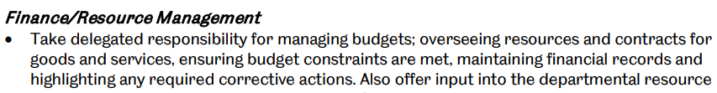
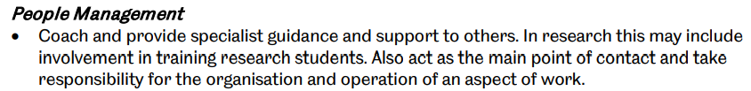

Grade 7 researcher
Notes:
Financial management
Command Centre PPIE
Project management
Student supervision
Communication
PPIE

Slide 5

What is a suitable candidate?
A researcher at grade 7 or above.
A programmer / scripter.
Someone competent with uncertainty.
A good communicator.
Someone competent across domains.

Slide 6
Programmer / Scripter

Slide 7
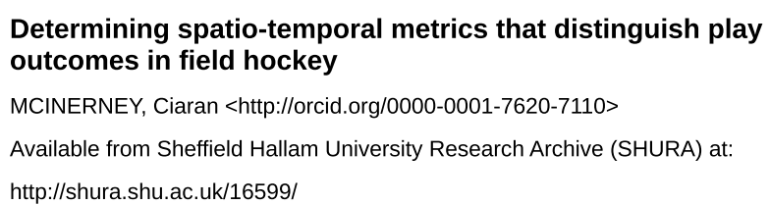

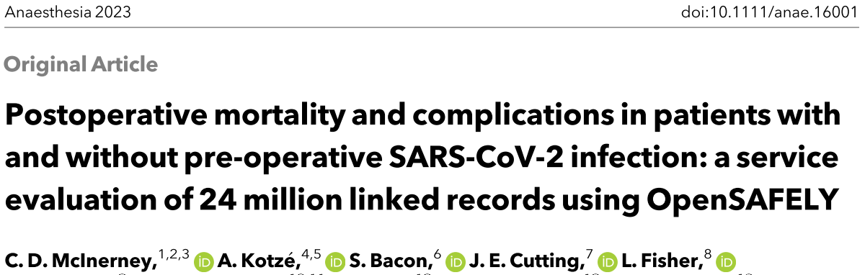

A programmer / scripter
Notes:
My scripting experience is with:
MATLAB, applying genomic selection methods.
R, for general use but most-recently for evaluating guidelines imposed on surgery units during the COVID years

Slide 8
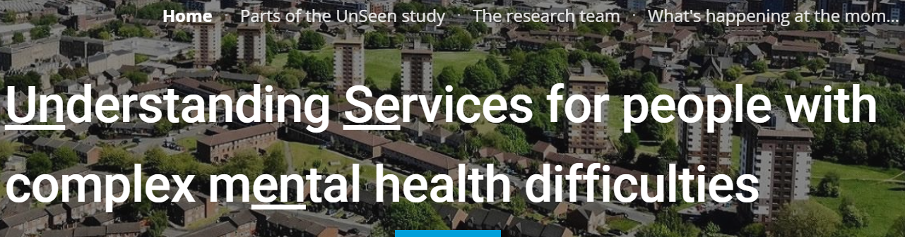

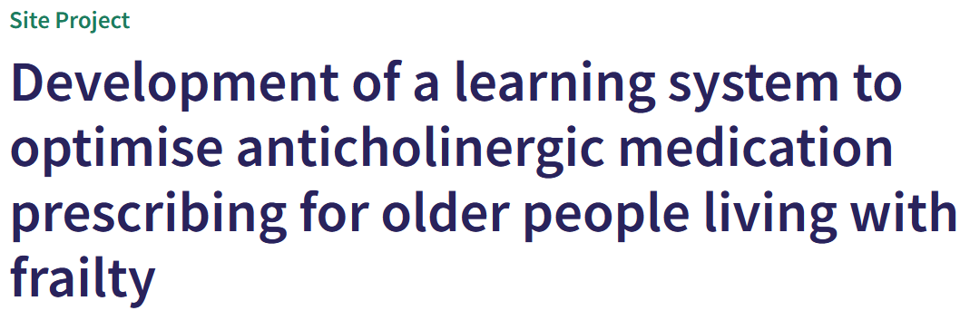


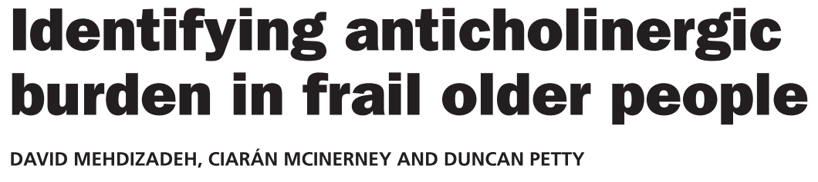
A programmer / scripter
Notes:
Python, taking an information-theoretic approach to identifying features of interest
Then there is my experience with VBA, which I consider to be a bit closer to proper programming rather than scripting. I’ve used VBA to programme clinical decision support tools within Microsoft Office applications.
There is also SQL and GoogleBigQuery, handling large datasets of patients’ electronic health records on various projects.
Finally, I have done a tiny bit of HTML but please don’t make me do any more.

Slide 9
What is a suitable candidate?
A researcher at grade 7 or above.
A programmer / scripter.
Someone competent with uncertainty.
A good communicator.
Someone competent across domains.

Slide 10
Competent with uncertainty
Notes:
What do I mean by this? I mean someone who understands how to work with uncertainty.
It would be helpful if the person was also familiar with uncertainty reduction techniques, particularly as they relate to simulations.
Perhaps more importantly, I’m talking about someone who understands what uncertainty is, what isn’t sources are, how we quantify it, how we describe it. Only someone who can do this will be able to help to maximally reduce aerosol forcing uncertainty.

Slide 11

Competent with uncertainty
Notes:
So, what are my credentials.
Well firstly, I am a student of statistics. I live in the that world and statistics – particularly inferential statistics – is all about uncertainty. Before moving to Sheffield recently, I was the Chair of the Royal Statistical Society Leeds-Bradford local group. This involved hosting events for statistical colleagues and, would you believe, some of events attracted in-person attendance from as far south as Southampton and as far north as Thirsk, even though remote attendance was offered. I’ve also taught statistical methods at undergraduate and master level.
But all I’ve said so far is just to say that I am very much part of the world that deals with uncertainty. But the brief for this presentation was about my prior work. It is a short step from talking about quantifying uncertainty to using such quantifications to improve understanding and inform decision making. That’s where sensitivity analyses come in.

Slide 12


Competent with uncertainty
Notes:
I was awarded a studentship from the EPSRC to work with English Hockey to figure out what descriptions of game play distinguish the outcome of a play: was it a goal, was it a miss, was it a corner? My output here was a set of variables: these ones distinguish goal from a miss, these ones distinguish a goal from a corner, etc. I studied how these variables performed individually, in pairs, and up to combinations of six.

Slide 13
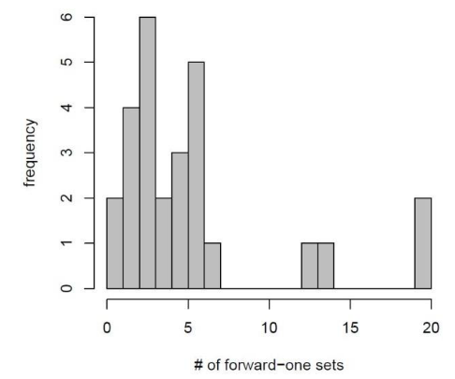
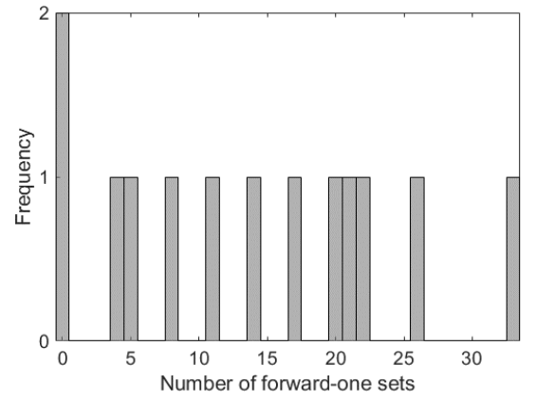
Competent with uncertainty
?
Wang et al (2012) 10.1093/bioinformatics/bts531
McInerney (2017) 10.7190/shu-thesis-00025
Notes:
An issue I had during my PhD was that the method I chose included three steps that required a subjective assessment of plots to determine thresholds. I spoke with the creator of the method, and he said that thresholds are usually quite obvious, so he didn’t worry about too much. But mine were not obvious, and I wasn’t comfortable with choosing only one path forward.

Slide 14

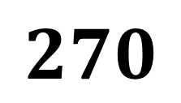



Competent with uncertainty
1
$$⋮$$
10
$$⋮$$
$$3$$
$$270$$
1
$$⋮$$
10
Notes:
The ramification was that I had 270 different paths that I could have taken, each resulting in a its own set of variables. A simple quantification of uncertainty would be to provide the count of unique variables across all sets, and the count of unique combinations of variables across all set.

Slide 15
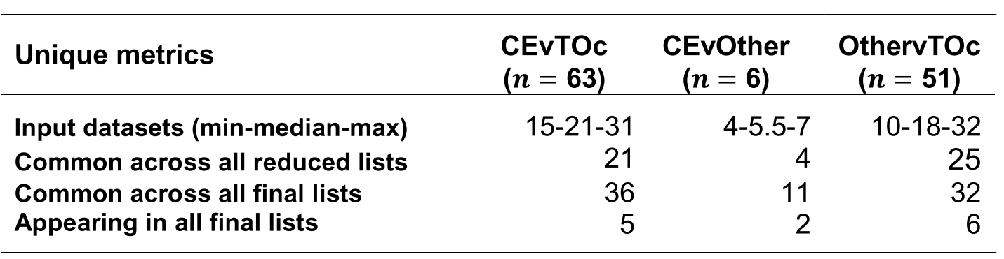




Competent with uncertainty
$$O=outcome$$
$$O_{1}vs O_{2}$$
$$O_{1}vs O_{3}$$
$$O_{2}vs O_{3}$$
Notes:
For example, comparing outcomes 1 and 2, we see that there were five variables that appeared in all model runs; they always showed up. And this is compared to the 36 variables that appeared at least once in all model runs.
So, what we are saying is that there were five variables whose strong performances were robust – or insensitive – to the subjective decisions in the workflow. And of the more-than-3,600 initial variables, 36 were sensitive to the workflow. Just for completeness, we can also say that the poor performances of the remaining 3,600ish variables were also robust – or insensitive – to the subjective decisions in the workflow

Slide 16
What is a suitable candidate?
A researcher at grade 7 or above.
A programmer / scripter.
Someone competent with uncertainty.
A good communicator.
Someone competent across domains.

Slide 17
Good communicator
Notes:
Why is high-quality communication important for this project? I propose that it is important for three main reasons:
The complexity of the underlying phenomena.
The complicatedness of the methods we are using.
The multi-disciplinarity of the team required to address the problem.
Each of these present many opportunities for error in our communication. There is a difference between being busy and being productive, and that difference is much easier to spot when we are dealing with something simple. So, if we want to be productive on this project, the successful candidate needs to be a good communicator.
Evidence of my high-quality communication include…

Slide 18



Good communicator
Teaching
Broadcast media
“[C]iarán, he was always super enthusiastic and engaging”
“Ciarán should be commended he is an asset to your team”
“Ciarán is an amazing teacher very enthusiastic and it was a pleasure to be taught by him”
“The lecturer called Ciarán was very engaging! Best lecture we had for RESS”.
“Ciarán was a good tutor and was good at explaining statistical concepts”
“Ciarán was an excellent teacher. He was entheusiastic [sic] and engaging and made sure he taught things in a way that everyone understood.”
Notes:
NOTE: The broadcast media appearances were all about the same topic: the physics of gymnastics. What I want to highlight is that I kept getting asked back to present, which suggests that I did a good job the previous times.

Slide 19







Good communicator
Outreach & Public Engagement
Notes:
NOTE:
I’m not saying the ideal candidate needs to be a science communicator. When bridging the gap between experts in different domains, it can be helpful to consider each other as laypeople with respect to the other person’s expertise.
I just mentioned the idea of bridging the gap between experts in different domains, which is useful because the next thing that I think the ideal candidate needs is to be competent across domains.

Slide 20
What is a suitable candidate?
A researcher at grade 7 or above.
A programmer / scripter.
Someone competent with uncertainty.
A good communicator.
Someone competent across domains.

Slide 21
Competent across domains
Notes:
I hope reason why this is important naturally follows from what I’ve said so far: we are dealing with complex phenomena, with complicated topics, as a multi-disciplinary team. It would help if all members of the team could work across their expertise rather than just throwing their spice in the mix leaving someone else to integrate everything.

Slide 22
competent across domains
Abstract and focus appropriately
Communicate effectively
Learn quickly
Notes:
I would break this one down into someone who can:
Abstract and focus appropriately,
Communicate effectively, and
Learn quickly.
I already spoke about communication. With respect to appropriate abstraction and focus…

Slide 23
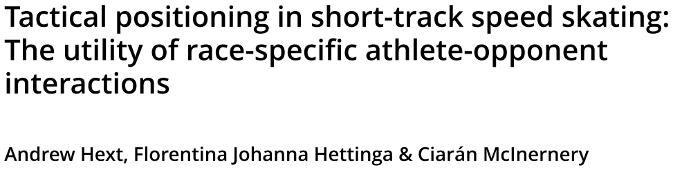
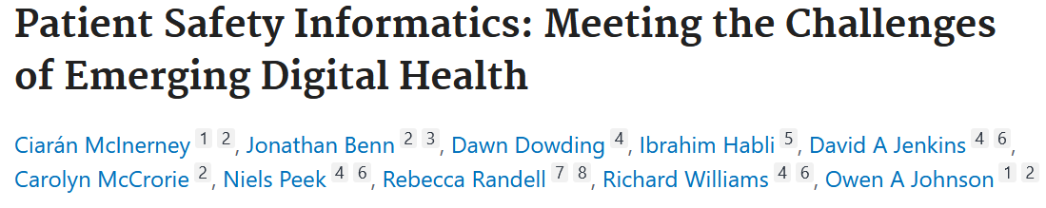
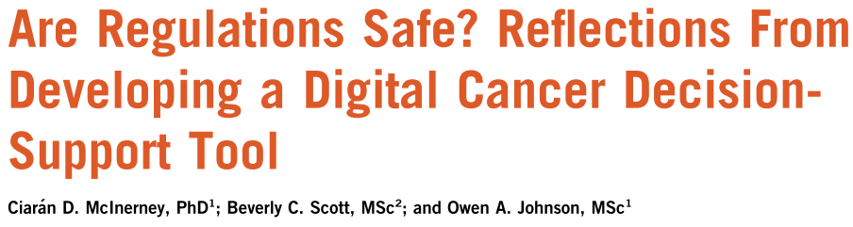
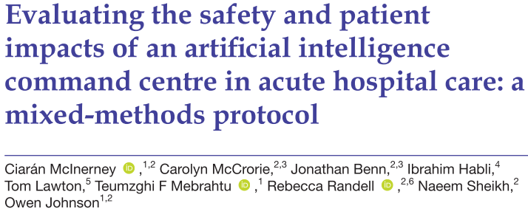
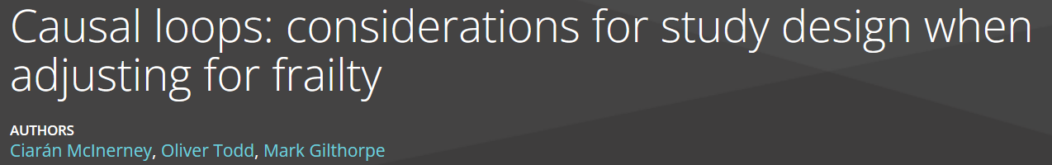
competent across domains
Sport
Electronic health records
and databases
Standards and regulations
Clinical decision support
Causal inference
Notes:
Firstly, I’d like to highlight the breath of domains in which I’ve worked. And I want to be clear that this doesn’t represent a scatterbrain. Instead, it represents my young career pursuing the fundamentals: ontology – what is the essence of things?; epistemology – how do we come to know things?; methodology – what’s the best way to do things?; and also my built-in disposition to figuring things out. This is why I like working on mixed-methods projects and with multi-disciplinary teams. Some examples of the domains in which I’ve work are shown on the slide.
Whether it is sport, health, statistical theory, bureaucratic regulations…it doesn’t matter. What I am good at it asking and answering how and why.

Slide 24
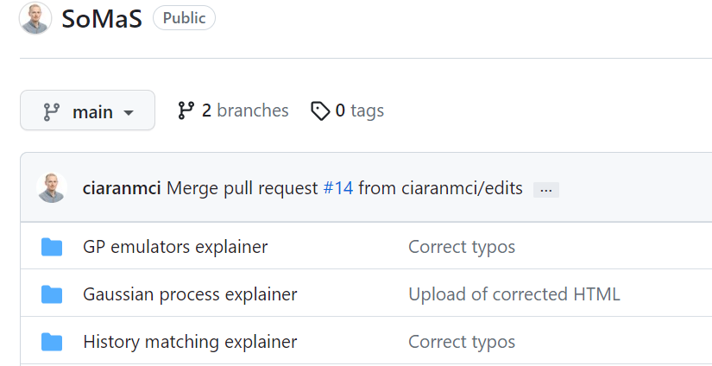
competent across domains
Learn quickly
Link
Link
Link
Notes:
With respect to the third trait – “learn quickly” – I offer as evidence the three explainers that I wrote and hosted on GitHub. I saw the advert for this post in mid-June and, before submission, I immersed myself in the world of Gaussian processes, Gaussian process emulators, and history matching. A good check of learning is to explain it to someone else, and that is what I attempted to do here. I don’t expect to have got everything correct, but I wanted to showcase how quickly I can develop an initial understanding and provide a report on it.

Slide 25
What is a suitable candidate?
A researcher at grade 7 or above.
A programmer / scripter.
Someone competent with uncertainty.
A good communicator.
Someone competent across domains.

Slide 27
Competent with uncertainty
Prevalence of feature
Prevalence of target variable
Scaled mutual information
Coincidence
Notes:
One example is my current work that is looking at the associations between features within patients’ electronic healthcare records and their indication of complex mental health difficulties. Long story short, I wanted to know for which range of input values would my output values lie within a permitted range. I adopted a simple simulation approach. Fortunately, I had a rationale for constraints on the inputs values, which helped to narrow my search. I then opted for a uniform spread of inputs within the constrained range. I didn’t need any fancy Latin hyper cube sampling or anything like that because my simulation was relatively trivial compare to climate models; I was just calculating various flavours of mutual information.
So, I was looking at the associations between features within patients’ electronic healthcare records and their indication of complex mental health difficulties. I permuted possible values for the prevalence of the features and of “complex mental health difficulties”, and permuted scenarios for coincidence. So, in essence, I was checking the sensitivity to a variety of input values and a variety of relationships between input variables. The result was that I was able to define a little rule book that would help me to quickly triage the many candidate features, once I found out the true prevalence of complex mental health difficulties, and the true prevalence of the candidate features. To give my clinical colleague some agency, I simplified my results into best-, moderate-, and worst-case scenarios.

Slide 28
Competent with uncertainty

